Slide 1
Semester Induction to III Semester (Academic Year 2024-2025)
BCA (Cloud Computing, Cyber Security & Ethical Hacking)

Slide 2
About the Class
Semester : III Semester
Programme : BCA (Artificial Intelligence, Machine Learning, Robotics and IoT)
Class Advisor:
Mr. Puneeth Raj K
Class Strength: 50 Students
Lecture Hall : LH 32, B Block

Slide 3
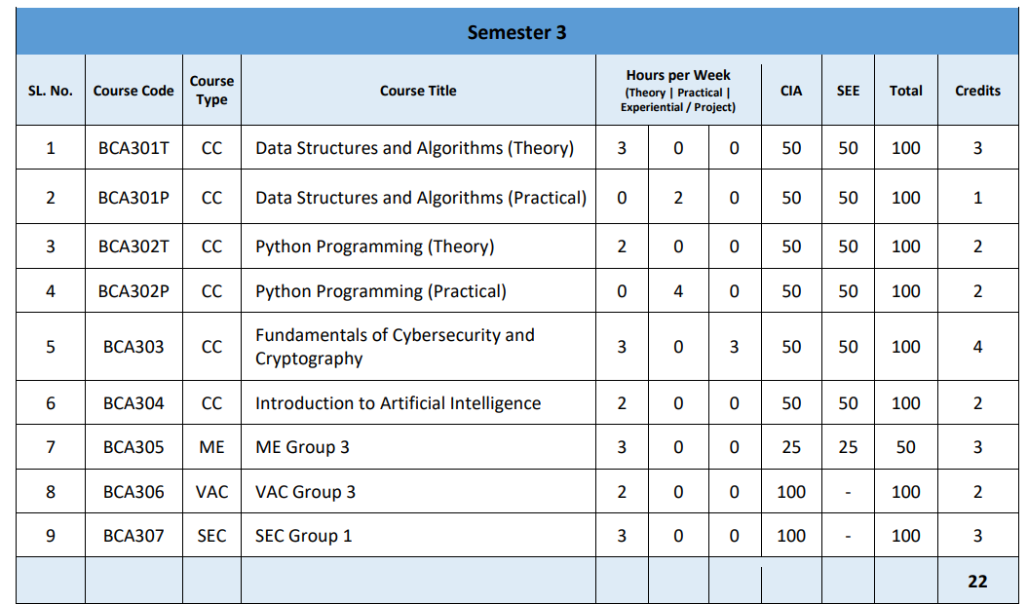
* Mandatory Non Credit Course. Passing is Mandatory

Slide 4
Credit hours for different types of Courses
A semester is of 15 weeks duration
One credit for lecture/tutorial work is equal to one hour of engagement per week, i.e. 15 hours in a Semester.
For example, 3 credit lecture course in a semester is
3 Hours per week X 15 weeks duration per semester =45 hours of teaching.
One credit for practical or lab work is equal to 2 hours duration per week. i.e. 30 hours in a Semester.
For example, 2 Credits practicul or lab work course in a semester is
4 Hours per week X 15 weeks duration per semester =60 hours of teaching.
6 Credits = 6 Hours per week X 15 weeks duration per semester = 90 hours of teaching.

Slide 5
Learning Hours Per Credit
Hours per credit
Theory (Lecture and Tutorials) | Practical Learning | Experiential / Project-based Learning
15 | 30 | 45

Slide 6
Attendance
75% Attendance is Mandatory to write semester end examination
A candidate who does not satisfy the requirement of attendance in 50% or more than 50% of the courses in a semester shall not be permitted to take the whole (all papers/subjects) University examination of that semester and he/she shall seek readmission.
Student having an attendance shortage in 50% of the courses or less than 50% of the courses (whatever may be the credits or type e.g. Theory /practical) will not be allowed to write the examination of those courses, during that semester.

Slide 7
Attendance
If students have shortage in 4 or more than 4 Courses out of 6 Courses including Practicals
Students should seek readmission for the next year for same semester.
If students have shortage in 3 or less than 23 Courses out of 6 Courses including Practicals
Students will not be allowed to write the examination of those subjects (attendance shortage subjects), during that semester.
Those paper (attendance shortage subjects) the student will enroll by paying a casual term fee as fixed by the university and will undertake remedial classes held during the semester vacation (either summer or winter) and fulfill the attendance requirement and can take the supplementary examination within 45 days of announcement of the regular examination results

Slide 8
Assessments and Evaluation
Assessment Scheme
Continuous Internal Examination | Semester End Examination
50% | 50%

Slide 9
Examination Structure
Examination/Assessment | All Courses (Except MEC/SEC) Marks | MEC/SEC Marks
Continuous Internal Assessment (CIA)* | 50 Marks | 25 Marks
Semester End Examination (SEE ) | 50 Marks | 25 Marks
Total | 100 Marks | 50 Marks

Slide 10
Parameters for CIA
Parameters for the Assessment | All Courses (Except MEC/SEC) Marks | MEC/ SEC Marks
Continuous Internal Assessment (CIA)* | 25 Marks | 13 Marks
Internal Assessment Test (IAT)* | 20 Marks | 10 Marks
Class Participation* | 5 Marks | 2 Marks
Total | 50 Marks | 25 Marks

Slide 11
Practical SEE
Components | Marks
*Part A : One Program | 15 Marks
*Part B : One Program | 25 Marks
Viva-Voce | 05 Marks
Record | 05 Marks
Total | 50 Marks
* This is a sample distribution.
Weightage over programs may be changed as per the requirements by the Dean/HoD

Slide 12
Minimum for a Pass
Students who scored minimum 40% marks in the Continuous Internal Assessment and Semester End Examination separately are declared to have passed the Semester Examination.
If a candidate fails in any course, he/she shall appear for that course in the supplementary examinations conducted within 45 days of regular semester end examination or subsequent regular examinations within the maximum of 7 years from the date of registration for the prescribed course and programmes.

Slide 13
Faculty Members
Course Title | Course Instructor
Data Structure and Algorithms | Ms.Arpitha S
Python Programming | Ms. Priya Kamath
Fundamentals of Cryptography and Cybersecurity | Ms. Ashwini K. Shetty
Introduction to Artificial Intelligence | Mr. Puneeth Raj K
SEC- Communication Skills
VAC -NSS | Mr. Arun Kumar

Slide 14
Additional Academic Activities
Sports Activities
Cultural Activities
Microsoft Training Sessions
Microsoft Certification Examination
Guest Lectures
Workshops
Soft skill Trainings

Slide 15
Contact Details
Mr. Puneeth Raj K : puneethrajk2000@gmail.com
Mr. Narayan Sukumar, Vice Principal : nsukumara@yenepoya.edu.in
Dr. Rathnakar Shetty P., HoD. : hodcs@yenepoya.edu.in /rathnakar@yenepoya.edu.in
Departmental of Computer Science : deptcs@yenepoya.edu.in
Accounts, Dept. of Computer Science : accountscs@yenepoya.edu.in
Accounts, YIASCM : accountsyiascm@yenepoya.edu.in
IT, YIASCM : ityiascm@yenepoya.edu.in
Student Welfare Officer (Girls Only) : yiascmstudentwelfareofficer@yenepoya.edu.in
Student Welfare Officer (Boys Only) : swoyiascm@yenepoya.edu.in
Hostel (Girls Only) : jeppugirlshostel@yenepoya.edu.in
Hostel (Boys Only) : jeppuhostel@yenepoya.edu.in

Slide 16
Websites
University Website : yenepoya.edu.in
College Website : yiascm.in
Yengage (Student learning Platform) : yengage.yenepoya.edu.in
Student Portal : student.yenepoya.edu.in
[All Fee Payments, View Attendance, View IA,
Examination Applications and Results]
Telegram channel

Slide 17


